Slide 1

Covid-19 Suraksha Kavach
Submitted by:
Bhavnoor Singh (G13/018/CSE1/2017)
Guneet Pal Singh (G13/028/CSE1/2017)
Jagmeet Singh Bhatia (G13/046/CSE1/2017)
Japjot Singh (G13/048/CSE1/2017)
Under the guidance of:
Mrs. Amanpreet Kaur
Department of Computer Science & Engineering
Guru Tegh Bahadur Institute of Technology

Slide 2
Covid-19 Suraksha Kavach
Project Description
Practical Aspect
Model Training
Accuracy/Loss Curves
Interpretation of Performance Measures
Approach Used
Test Case
References

Slide 3
Project Description
The purpose of the project is to use the detection camera combined with Computer Vision to detect people without masks and whether social distancing norms are being obeyed or not.
The proposed system focuses on how to identify the person on image/video stream wearing face mask with the help of computer vision and deep learning algorithm by using the OpenCV, Tensor flow and Keras library.
Face Mask Detection Platform uses Convolutional Neural Networks to recognize if a user is not wearing a mask. The app can be connected to any existing or new detection cameras to detect people without a mask.
Social Distancing Platform opens a camera frame, the algorithm first detects visible people in the scene and estimates the distance between the detected people in the frame. It is intended as an indication of safe distance compliance.
For building this model, about 3,833 images with 1,915 images containing people with face masks and 1,918 images containing people without face masks.
The focus of this project is to prevent the spreading of coronavirus disease by urging people through its Face Mask and Social Distancing detection platform so that the covid-19 norms can be maintained properly.

Slide 4
Practical Aspect
Covid-19 is spreading at an alarming rate and to control that social distancing and wearing mask is the only solution. A user-friendly application which strongly encourages people to maintain covid-19 norms.
It can be installed at:
Airports to detect travelers without masks and distancing so that If a traveler is found to be without a face mask, the airport authorities could take quick action.
Hospitals can monitor if their staff is wearing masks and distancing norms during their shift or not.
Also, if quarantine people who are required to wear a mask, the system can keep an eye and detect if the mask is present or not report to the authorities.
System can be used at office premises to detect if employees are maintaining safety standards at work.
Multi-Channel Recognition: Attach multiple cameras in a few minutes and enable all the cameras to access the AI capability of recognizing faces.
Automatically Send Alert: Send alert to the faces which are recognized, also set the rate of sending the alerts and detection of faces.
No new hardware to install: The system can work on any existing RTSP camera without the installation of any new cameras. Most of the hospitals and airports have IP cameras installed and RTSP-enabled.

Slide 5
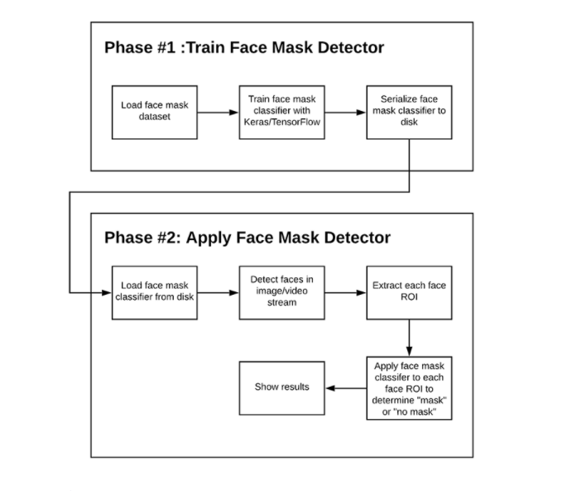
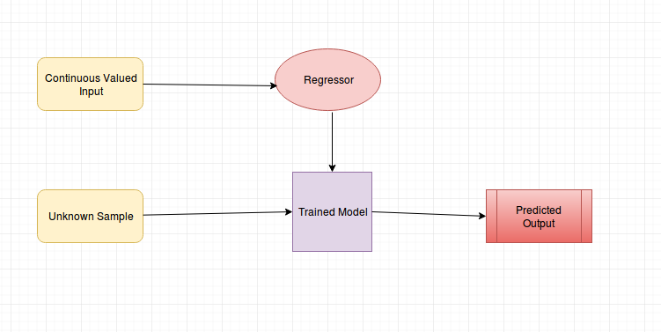
Model Training
Two Phase Face Mask Detector
In order to train a custom face mask detector, we need to break our project into two distinct phases, each with its own respective sub-steps (as shown by Figure):
Training: Here we’ll focus on loading our face mask detection dataset from disk, training a model (using Keras/TensorFlow) on this dataset, and then serializing the face mask detector to disk
Deployment: Once the face mask detector is trained, we can then move on to loading the mask detector, performing face detection, and then classifying each face as with mask or without mask.
For model training, the dataset consist of 3,833 images belonging to two classes:
With Mask: 1915 images
Without Mask: 1918 images
Fig 1: Linear Regression Flowchart
Figure 1: Two Phase Face Mask Detector

Slide 6
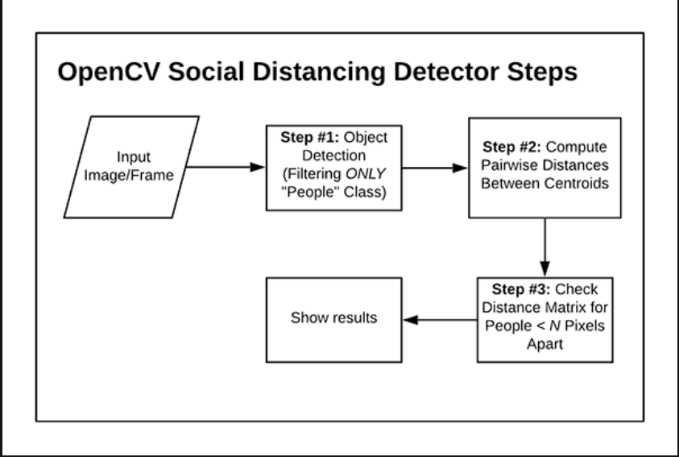
2. Social Distancing Detector Phases
Use OpenCV, computer vision, and deep learning to implement social distancing detectors.
The steps to build a social distancing detector include:
Apply object detection to detect all people (and only people) in a video stream.
Compute the pairwise distances between all detected people
Based on these distances, check to see if any two people are less than N pixels apart.
For the sake of simplicity, our OpenCV social distancing detector implementation will rely on pixel distances.
Figure 2: Social Distancing Detector Phases

Slide 7
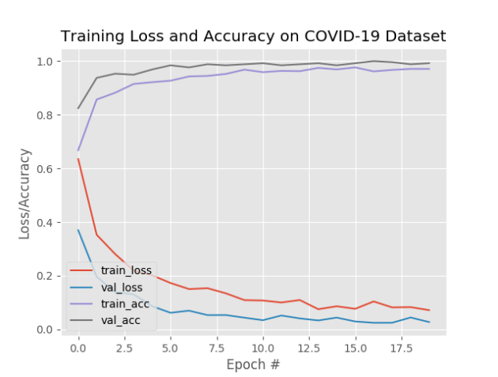
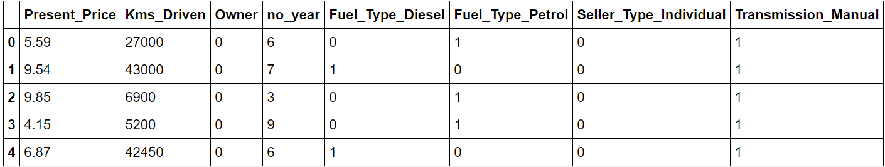
Accuracy/Loss Curves
Figure 3: COVID-19 face mask detector training accuracy/loss curves demonstrate high accuracy

Slide 8
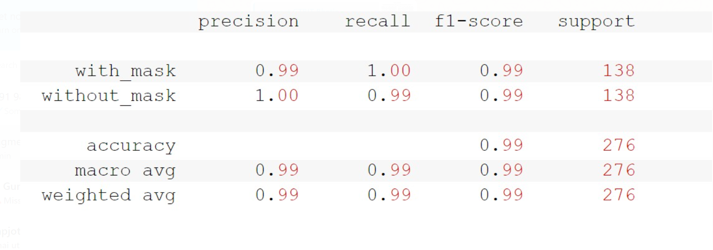
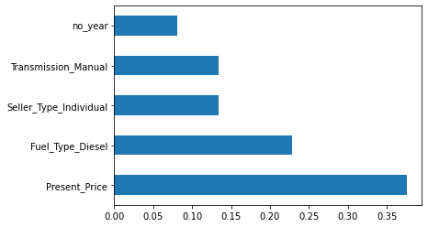
Interpretation of Performance Measures
Figure 4: Precision, recall, f1-score and support values

Slide 9
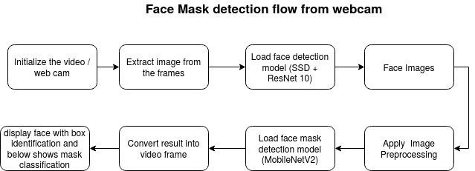
Approach Used
1. Face Mask Approach:
Train Deep learning model (MobileNetV2) and
Apply mask detector over images / live video stream.
Figure 5: Face Mask Detection Approach

Slide 10
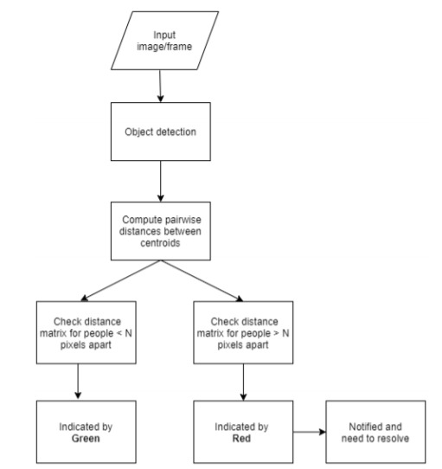
2. Social Distancing Approach:
The project uses OpenCV with a HAAR Cascade Classifier trained on faces to:
extract face from the webcams
classifies the distance in real time!
Figure 6: Social Distancing Approach

Slide 11
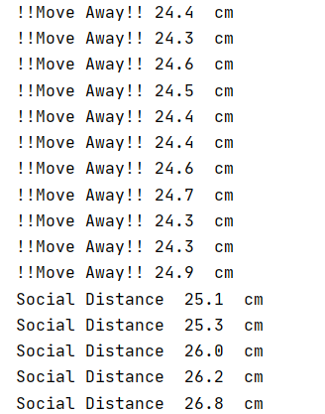
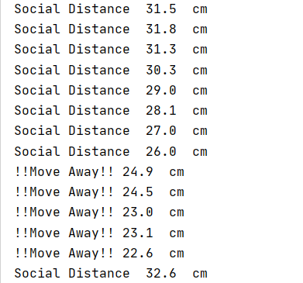
Test Case
Social Distancing:
If distance ‘D’:
D < 25 cm
Output: !!Move Away!! D cm
D > 25 cm
Output: Social Distance D cm
Figure 7: Test Case 1
Figure 8: Test Case 2

Slide 12
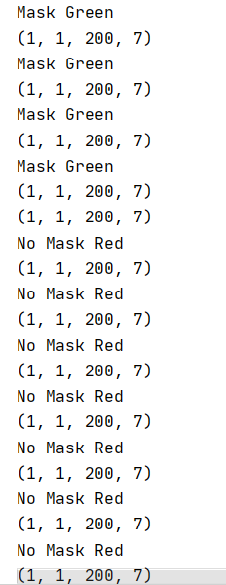
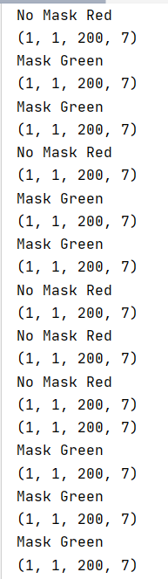
2. Face Mask
If Face Mask is:
On Face
Output: Mask Green
Not on Face
Output: No Mask Red
Figure 9: Test Case 1
Figure 10: Test Case 2

Slide 13
References
G.A.F Seber and A.J. Lee, Linear Regression Analysis. John Wiley & Sons Publishers, USA, 2012.
Baldi, P., Frasconi, P., Smyth, P. (2003). Modeling the Internet and the Web - Probabilistic Methods and Algorithms.
Lim, D.H., Kim, J.S., Lee, B.G., Wave Information Estimation and Revision Using Linear Regression Model. Journal of Korea Multimedia Society, 19, 8 (2016), 1377-1385.
Rivest, R.L. (1987). Learning decision lists. Machine Learning,2, 229-246.
Chan YH. Biostatistics 201: Linear regression analysis. Age (years). Singapore Med J 2004;45:55-61.
Chakrabarti, S. (2003). Mining the Web, Morgan Kaufmann.
Cohen, P.R. (1995) Empirical Methods in Artificial Intelligence. Cambridge, MA: MIT Press. This is an excellent reference on experiment design, and hypothesis testing, and related topics that are essential for empirical machine learning research.
Brunak, S. (2002). Bioinformatics: A Machine Learning Approach. Cambridge, MA: MIT Press.
Rivest, R.L. (1987). Learning decision lists. Machine Learning,2, 229-246.
Quinlan, J.R. (1986). Induction of decision trees. Machine Learning, 1, 81-106.

Slide 14
C. Cortes and V. Vapnik. Support-vector networks. Machine learning, 20(3):273–297, 1995.
Monitoring Social Distancing for Covid-19 Using OpenCV and Deep Learning by Rucha Visal, Atharva Theurkar, Bhairavi Shukla.
Ibiyemi T.S., Ogunsakin J., Daramola S.A. 2012.“Bi-Modal Biometric Authentication by Face Recognition and Signature Verification”, International Journal of Computer Applications, vol.42, no. 20, pp 17-21.
Object Detection and Tracking using Deep Learning and Artificial Intelligence for Video Surveillance Applications by Mohana and HV Ravish Aradhya.
S. Feng, C. Shen, N. Xia, W. Song, M. Fan, and B. J. Cowling, “Rational use of face masks in the covid19pandemic,”The Lancet Respiratory Medicine, 2020.
P. A. Rota, M. S. Oberste, S. S. Monroe, W. A. Nix, R. Campagnoli, J. P. Icenogle, S. Penaranda, B. Bankamp,K. Maher, M.-h. Chenet al., “Characterization of a novel coronavirus associated with severe acute respiratorysyndrome,”science, vol. 300, no. 5624, pp. 1394–1399, 2003
Zhang C., Zhang Z. A Survey of Recent Advances in Face Detection. Microsoft Corporation; Albuquerque, NM, USA: 2010. TechReport, No. MSR-TR-2010-66.
Monitoring COVID-19 social distancing with person detection by Narinder Singh Punn, Sanjay Kumar Sonbhadra and Sonali Agarwal.
COVID-19 and Importance of Social Distancing by Fahim Aslam.
Monitoring Social Distancing for Covid-19 Using OpenCV and Deep Learning Rucha Visal, Atharva Theurkar, Bhairavi Shukla

Slide 15
THANK YOU

